Slide 1
CLC1151: Chinese 1 (For Non-Chinese Speaking Students) nǐ hǎo 你好
Chinese Language Centre
PolyU
Sarah Wong

Slide 2
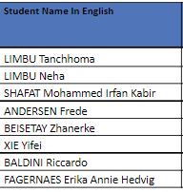
Warm reminder: Placement Test
Please submit to blackboard ASAP, thank you

Slide 3
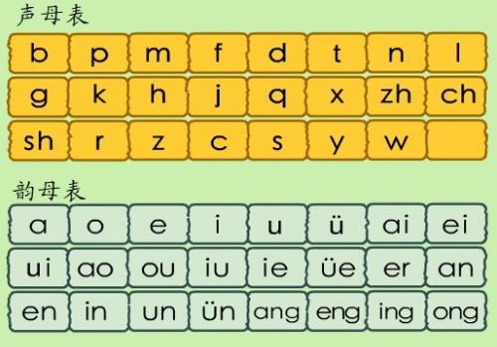
Revision: let’s read together
youtube
ia, ian, uai, ua,
uo,uan, iong
One by one + Group practice

Slide 4
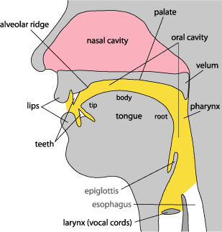
shēng mǔ
声 母
Initials
zh、ch、sh、r
zh（i） | 1)Roll up the tip of the tongue towards the front part of hard palate 2) Block the airflow 3) Unblock the airflow, squeeze the air stream through a narrow gap between the tongue and hard palate 4)Similar to “ge” in the English word “age / judge”.
r（i） | 1)Keep the same tongue position as “shi”, but with vocal cords vibrating all the time 2) Similar to “r” in the English word “rip”

Slide 5

Youtube Video

Slide 6
Pinyin Practice Initials + Finals
Initials:
d
t
g
k
f
Finals
ei ou an ang eng
iao iu
Group practice

Slide 7
Read Together: Textbook Lesson 1

Slide 8
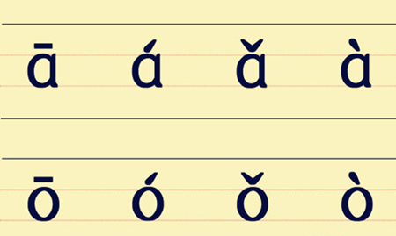
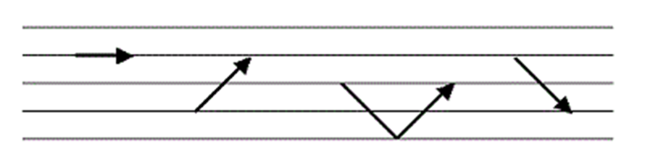
Tones
Where should I put the tone marks?
Please find out the rules. Worksheet.
Above the finals, not initials.
Follow the order of finals on Pinyin table, “a” first, and then “o”, “e”, “i” etc.

Slide 9
Tones
Write down the tones you hear.
Group practice: Table of Combinations of Initials and Finals in Putonghua.

Slide 10
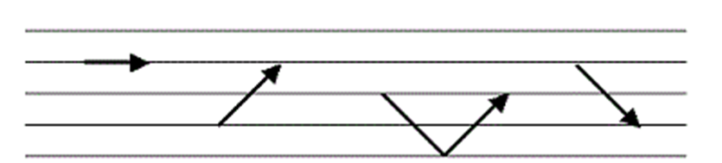
Neutral tone
+
Neutral tone

Slide 11
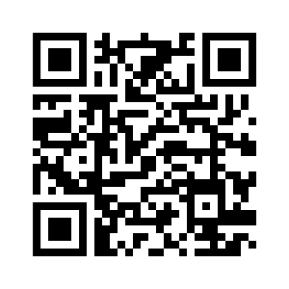
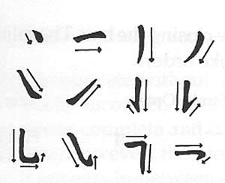
Get your Chinese name
http://www.mandarintools.com/chinesename.html
Try to write your
Chinese name correctly

Slide 12
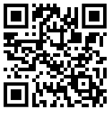
Post your names
https://padlet.com/sarahwong9/c96tk3jqitf2bduy

Slide 13
Greetings
Page 3, 4
nǐ hǎo
nǐ hǎo ma ?
wǒ hěn hǎo, nǐ ne?
yě hěn hǎo
Videos: 你好，你好吗？
ma: yes/no question
ne: what/where/why/how/who/
Practice time

Slide 14
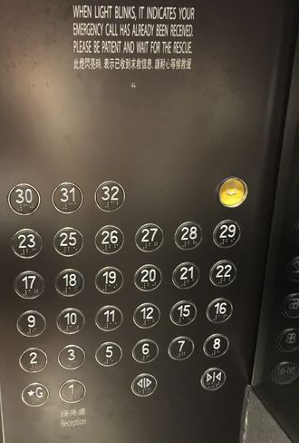

Basic Chinese Characters and numbers
零（〇）líng
一yī 、二èr、三sān，and then?
四sì、五wǔ、六liù
七qī、八bā、九jiǔ
十shí
shí zì jià
十字架

Slide 15
Worksheet for Chinese numbers

Slide 16
Write basic strokes
土
、
一
丨
丿
㇏
㇀
十
八
下
上

Slide 17
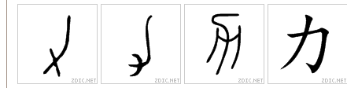
力 lì
Power, strength

Slide 18
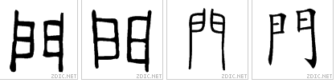
门（門）mén
door
也 yě
Also, too
力

Slide 19
Practice
Page 6 & 7.

Slide 20
Tone Mark Practice
Remember the rules of marking the four tones?
See worksheet.

Slide 21
Homework in Lunar New Year Break
Watch previous students’ samples.
Produce your own lesson 1 video (PolyU version).
2 dialogues in 1 video.
With your classmates/other friends.
Our assistants will add effects for you (bgm, subtitles, pictures…) You only need to take video.
Deadline: 29 Jan 2023, 11:59pm.

Slide 22
zài jiàn 再见
xīn nián kuài lè
新 年 快 樂（乐）

